Slide 1
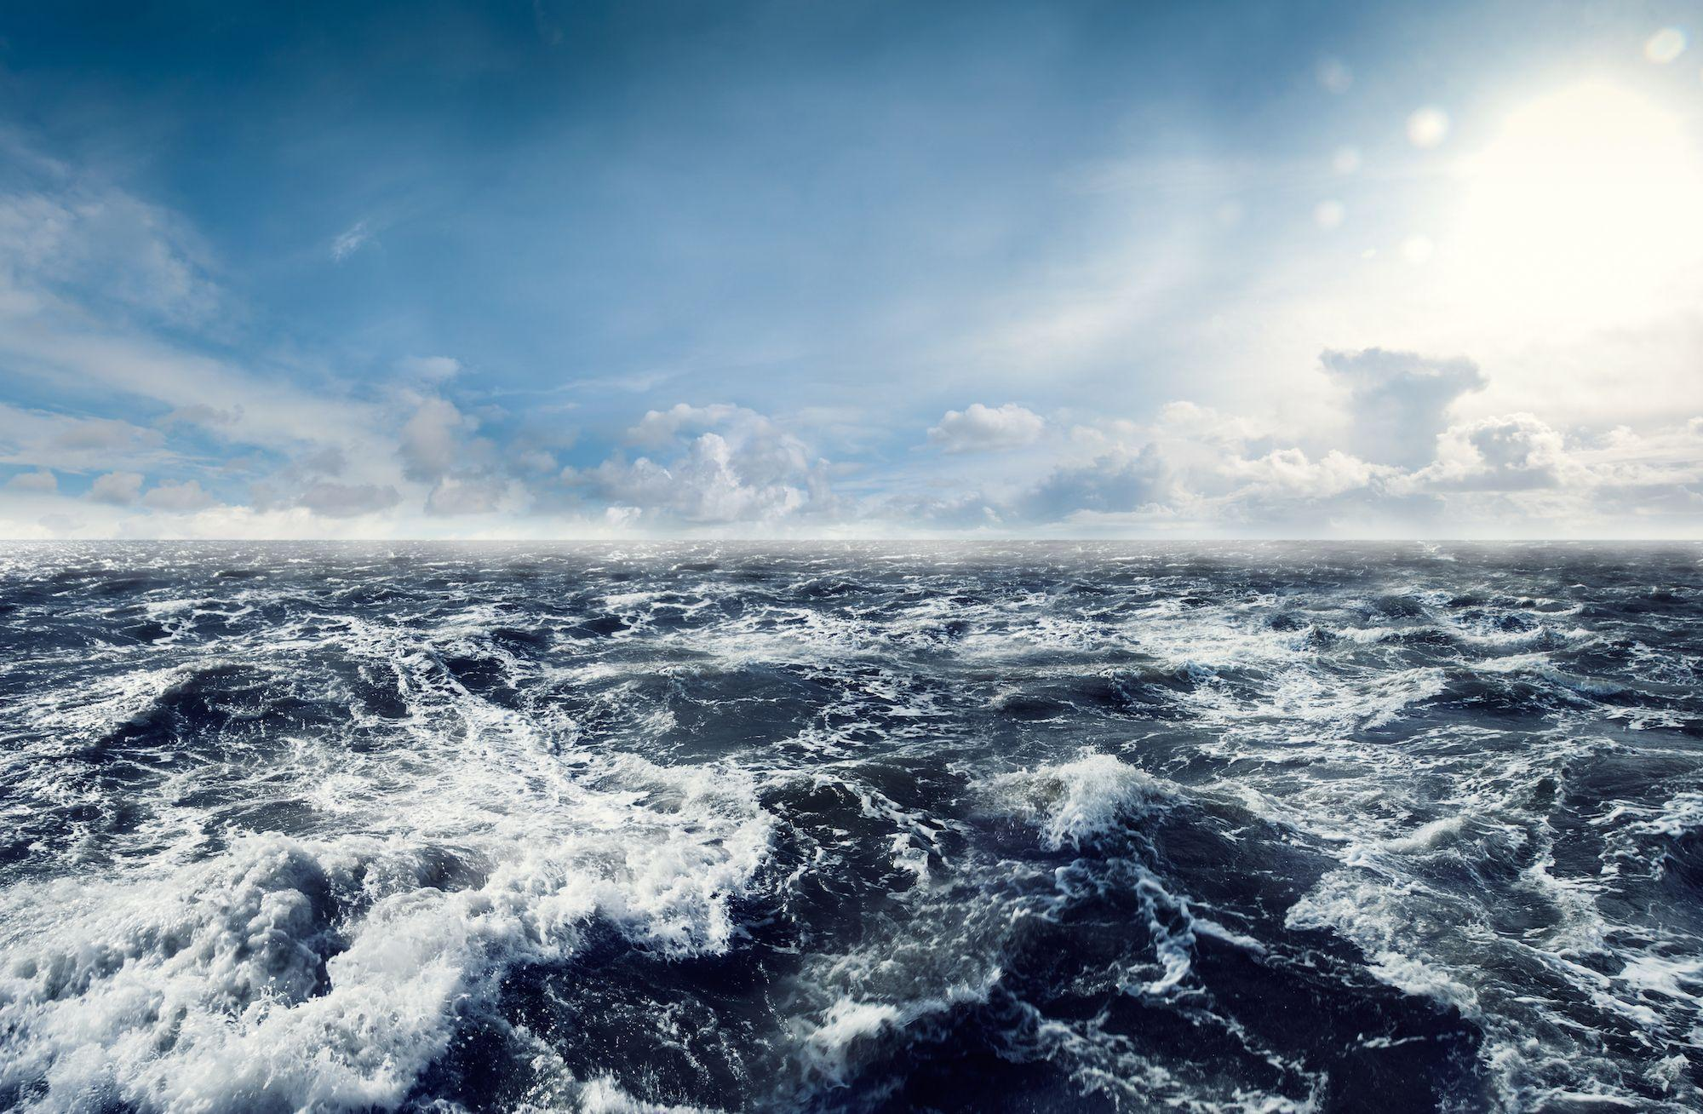
Sea Level Rise with Linear Regression
Chace Daskalos, Swati Goyal, Andrew Hoeppner

Slide 2
Selected Topic

Slide 3
Reason Topic was selected

Slide 4
Description of source of data

Slide 5
Question team hopes to answer with the data

Slide 6
Description of data exploration phase

Slide 7
Description of the analysis phase

